Slide 1
Prof. dr. Sophie Manigart, Vlerick Business School and Ghent University
SME Market Financing:
An academic perspective

Slide 2

Only 7% of European SMEs report that
access to finance is is a pressing problem.

Slide 3
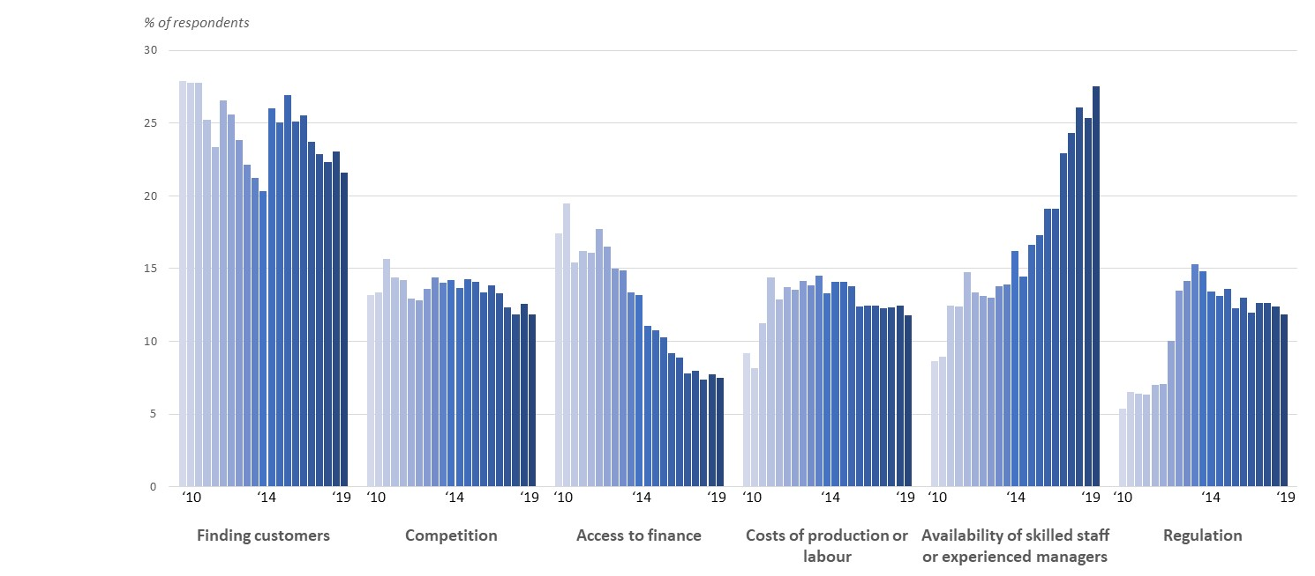
The most pressing problems faced by euro area SMEs
Source: SAFE april-september 2019
Notes:
Source: SAFE april-september 2019
http://sdw.ecb.europa.eu/browseTable.do?org.apache.struts.taglib.html.TOKEN=59e2a5ccbe842ffc0f9db0ff9e03f550&sk=235.SAFE.H.U2.SME.A.0.0.0.Q0.ZZZZ.P1.AL.WP&sk=235.SAFE.H.U2.SME.A.0.1.0.Q0.ZZZZ.P1.AL.WP&sk=235.SAFE.H.U2.SME.A.0.2.0.Q0.ZZZZ.P1.AL.WP&sk=235.SAFE.H.U2.SME.A.0.3.0.Q0.ZZZZ.P1.AL.WP&sk=235.SAFE.H.U2.SME.A.0.4.0.Q0.ZZZZ.P1.AL.WP&sk=235.SAFE.H.U2.SME.A.0.9.0.Q0.ZZZZ.P1.AL.WP&sk=235.SAFE.H.U2.SME.C.0.0.0.Q0.ZZZZ.P1.AL.WP&sk=235.SAFE.H.U2.SME.I.0.0.0.Q0.ZZZZ.P1.AL.WP&sk=235.SAFE.H.U2.SME.S.0.0.0.Q0.ZZZZ.P1.AL.WP&sk=235.SAFE.H.U2.SME.T.0.0.0.Q0.ZZZZ.P1.AL.WP&sk=235.SAFE.H.U2.SME.A.0.0.0.Q0.ZZZZ.P1.AL.WP&sk=235.SAFE.H.U2.SME.A.0.1.0.Q0.ZZZZ.P1.AL.WP&sk=235.SAFE.H.U2.SME.A.0.2.0.Q0.ZZZZ.P1.AL.WP&sk=235.SAFE.H.U2.SME.A.0.3.0.Q0.ZZZZ.P1.AL.WP&sk=235.SAFE.H.U2.SME.A.0.4.0.Q0.ZZZZ.P1.AL.WP&sk=235.SAFE.H.U2.SME.A.0.9.0.Q0.ZZZZ.P1.AL.WP&sk=235.SAFE.H.U2.SME.C.0.0.0.Q0.ZZZZ.P1.AL.WP&sk=235.SAFE.H.U2.SME.I.0.0.0.Q0.ZZZZ.P1.AL.WP&sk=235.SAFE.H.U2.SME.S.0.0.0.Q0.ZZZZ.P1.AL.WP&sk=235.SAFE.H.U2.SME.T.0.0.0.Q0.ZZZZ.P1.AL.WP&df=true&ec=&dc=&oc=&pb=&rc=&DATASET=0&removeItem=&removedItemList=&mergeFilter=&activeTab=SAFE&showHide=&REF_AREA.196=U2&FIRM_SIZE.196=SME&FIRM_SECTOR.196=A&FIRM_AGE.196=0&SAFE_QUESTION.196=Q4&SAFE_ANSWER.196=V1&MAX_DOWNLOAD_SERIES=500&SERIES_MAX_NUM=50&node=9689717&SERIES_KEY=235.SAFE.H.U2.SME.A.0.0.0.Q4.FBLN.V1.AL.WP&SERIES_KEY=235.SAFE.H.U2.SME.A.0.0.0.Q4.FDSE.V1.AL.WP&SERIES_KEY=235.SAFE.H.U2.SME.A.0.0.0.Q4.FEQI.V1.AL.WP&SERIES_KEY=235.SAFE.H.U2.SME.A.0.0.0.Q4.FFAC.V1.AL.WP&SERIES_KEY=235.SAFE.H.U2.SME.A.0.0.0.Q4.FGSL.V1.AL.WP&SERIES_KEY=235.SAFE.H.U2.SME.A.0.0.0.Q4.FIFN.V1.AL.WP&SERIES_KEY=235.SAFE.H.U2.SME.A.0.0.0.Q4.FLEH.V1.AL.WP&SERIES_KEY=235.SAFE.H.U2.SME.A.0.0.0.Q4.FLHF.V1.AL.WP&SERIES_KEY=235.SAFE.H.U2.SME.A.0.0.0.Q4.FOLN.V1.AL.WP&SERIES_KEY=235.SAFE.H.U2.SME.A.0.0.0.Q4.FOTH.V1.AL.WP&SERIES_KEY=235.SAFE.H.U2.SME.A.0.0.0.Q4.FOVD.V1.AL.WP&SERIES_KEY=235.SAFE.H.U2.SME.A.0.0.0.Q4.FSPL.V1.AL.WP&SERIES_KEY=235.SAFE.H.U2.SME.A.0.0.0.Q4.FTCR.V1.AL.WP&SERIES_KEY=235.SAFE.H.U2.SME.A.0.0.0.Q4.FXXX.V1.AL.WP

Slide 4
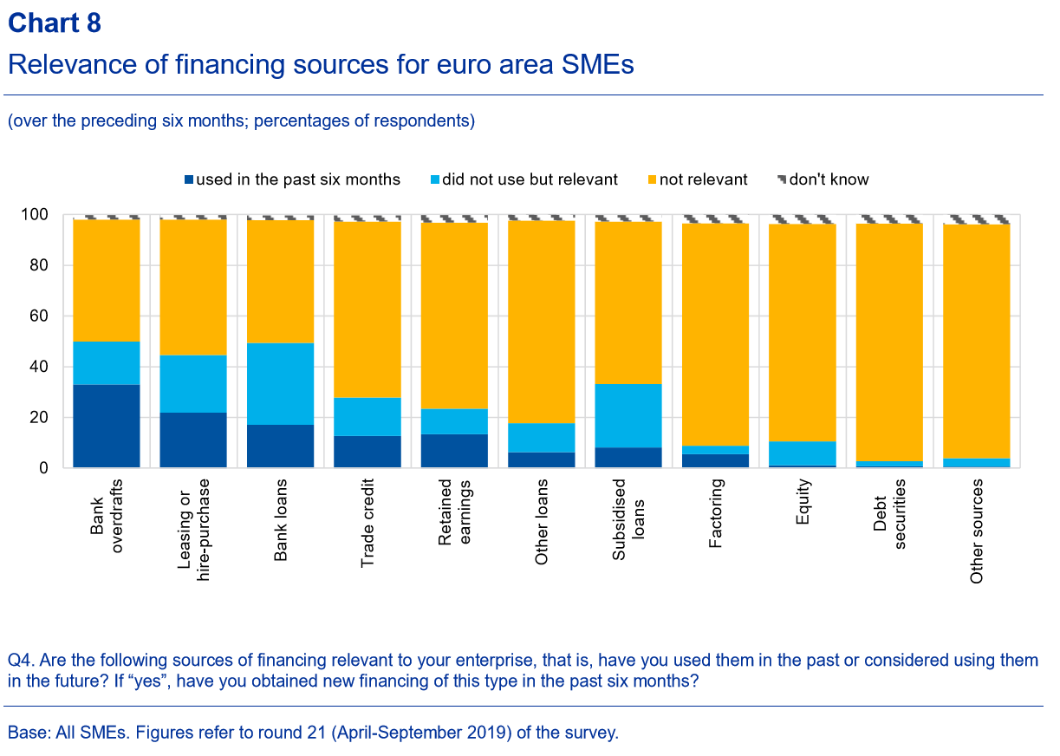
Source: SAFE april-september 2019

Slide 5
European Family firms: probability of issuing external equity (n=160)
Short term (1-3 years)
Long term (5 years)

Slide 6
Family firms: preferred type of investors

Slide 7


Slide 8
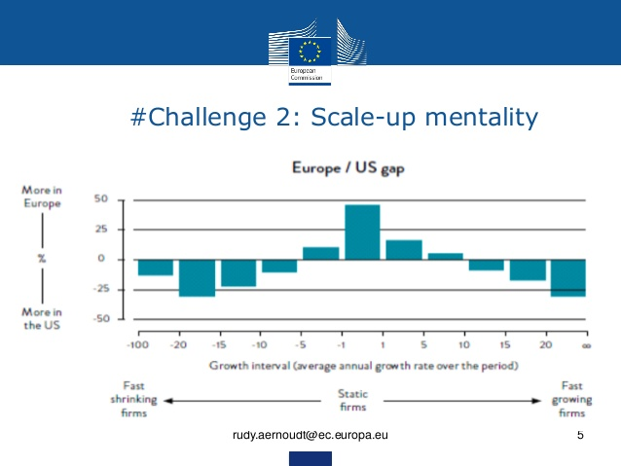

Slide 9
Key challenges for European scale-ups?

Slide 10

Number Three challenge for growth...

Slide 11
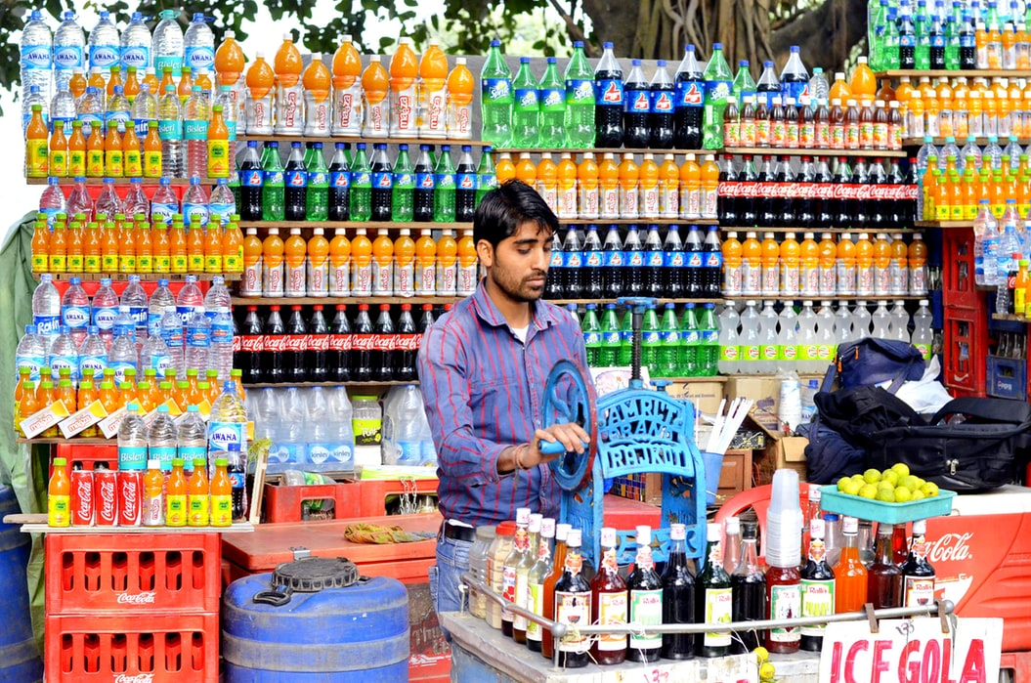

Slide 12

Number Two challenge for growth...

Slide 13


Slide 14

Number one challenge for growth...

Slide 15

N° 1 challenge
Access to finance

Slide 16
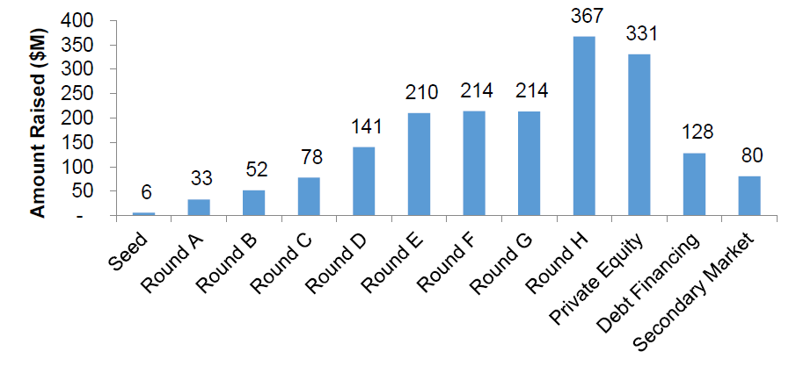
Unicorns require a lot of funding
Duruflé, Hellmann & Wilson, 2017. From Start-Up to Scale-Up: Examining Public Policies
for the Financing of High Growth Ventures. Saïd Business School Research Paper.

Slide 17
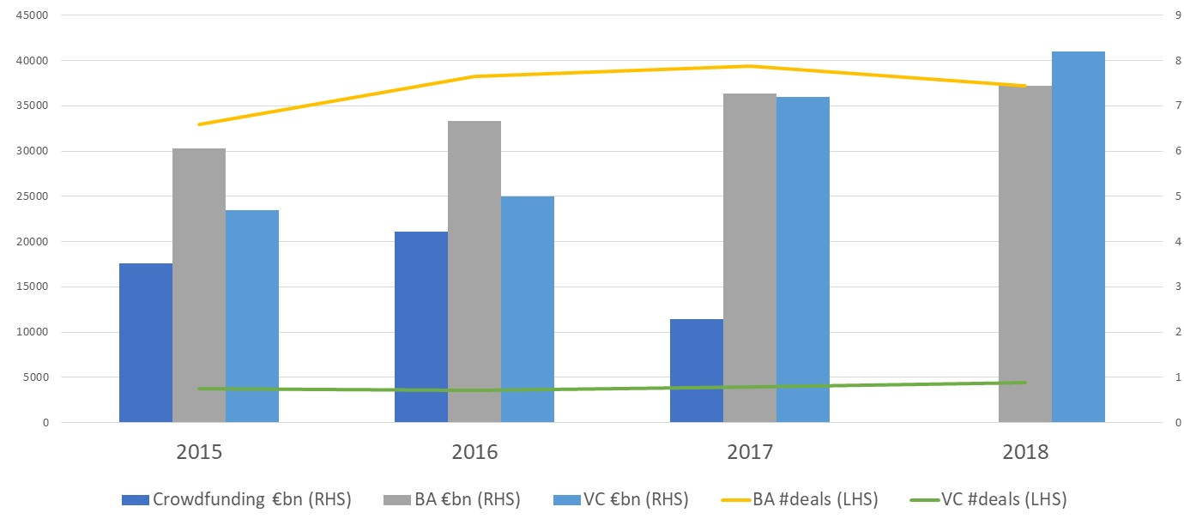
Crowdfunding, BA and VC
Amounts invested (€bn) and number of deals, Europe
Various sources
Notes:
Sources: Invest Europe (VC), European Business Angels Network (BA), “Identifying market and regulatory obstacles to crossborder development of crowdfunding in the EU “, 2017 EC report
ATTENTION: Crowdfunding: not all EU countries are included. This number is based on aggregate data from 17 EU countries. (+ UK accounts for nearly 90% of EU crowdfunding fundraising; source: Bruegel, 2019).

Slide 18
SME IPOs in Europe
€M
# IPOs
Source: European Commission
Notes:
Source: European Commission (via https://www.esma.europa.eu/sites/default/files/library/esma22-106-535_smsg_report_on_access_to_public_capital_markets_for_smes.pdf)

Slide 19
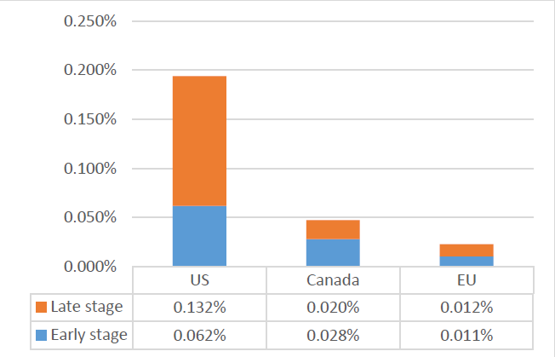
VC in Europe lags US & Canada in VC as % GDP

Slide 20
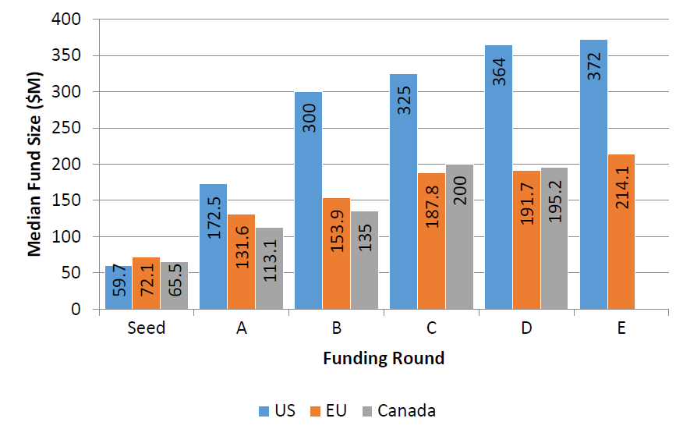

Slide 21


Slide 22
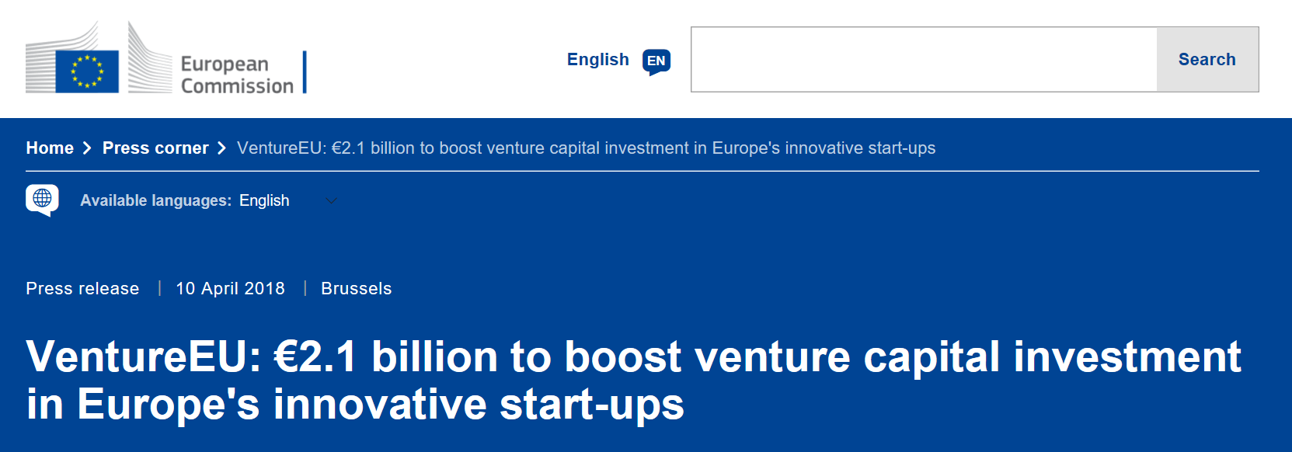
EU: €410 million in 6 private VC fund-of-funds

Slide 23
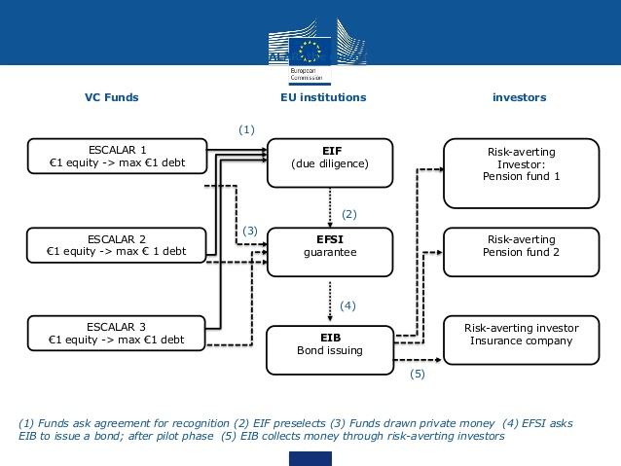
EU: ESCALAR

Slide 24
Government intervention
Build conducive institutional environment
Support private sector, do not distort
Leave investment decisions to (private) professionals

Slide 25
Let’s connect
Sophie.Manigart@Vlerick.com

