Slide 1

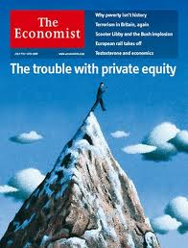



VC/PE: a misunderstood asset class
Page 1 - 22/11/2013 – Luxembourg Investment Forum 2013 (LIF 2013)
Page 1 - 09/12/2021

Slide 2
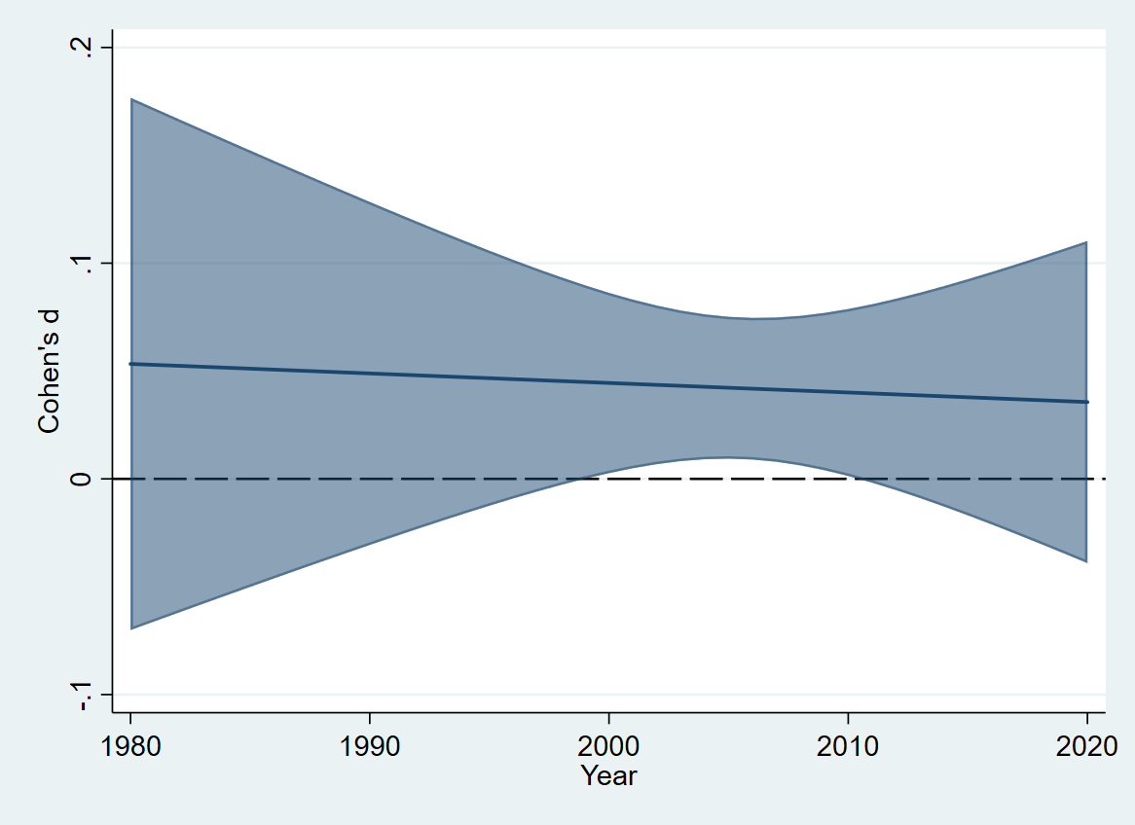
Buyouts have some impact on efficiency
Result of a meta-analysis covering 480,000 buyouts
Positive effect driven by Anglo-Saxon countries
No efficiency effect in Europe
Source: Verbouw, Manigart & Meuleman, 2021

Slide 3
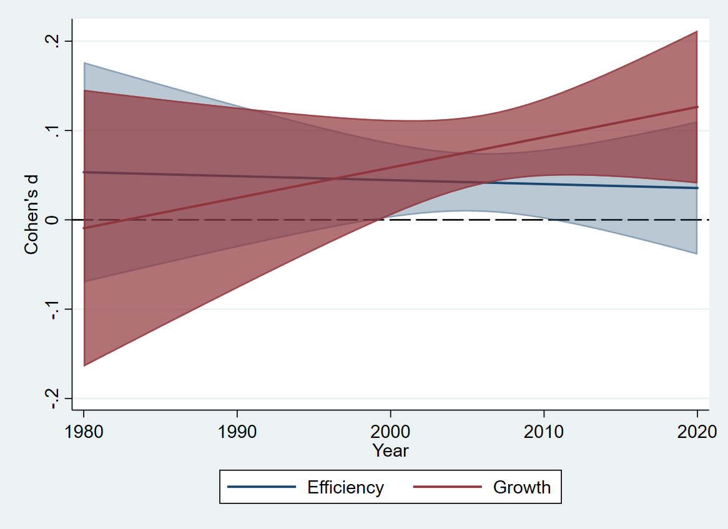
Buyouts positively impact growth
Especially in more recent years
Source: Verbouw, Manigart & Meuleman, 2021

Slide 4
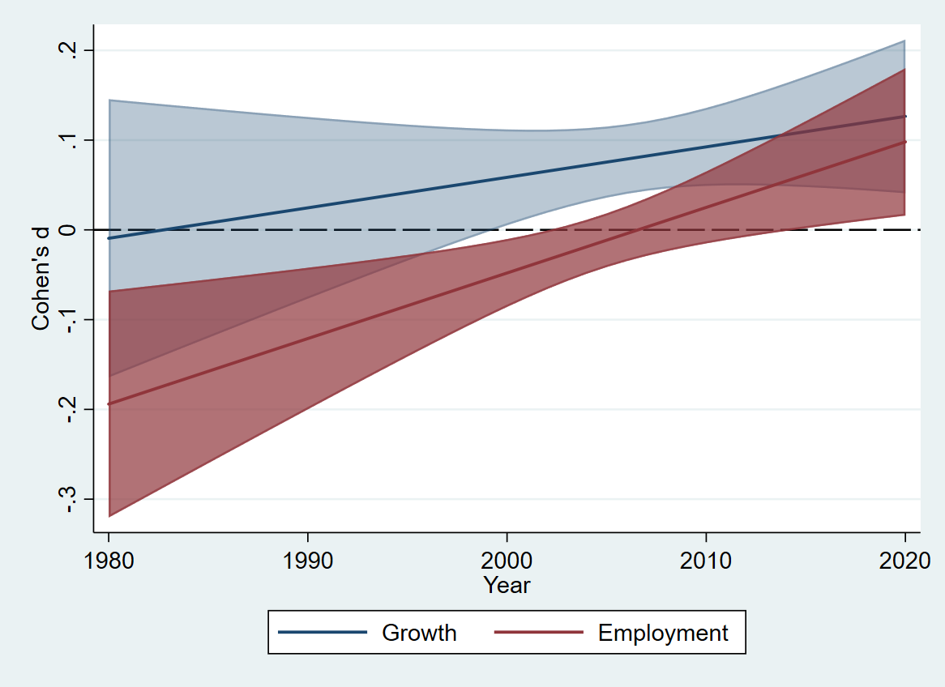
Since 2010, buyouts contribute to employment
Source: Verbouw, Manigart & Meuleman, 2021

Slide 5
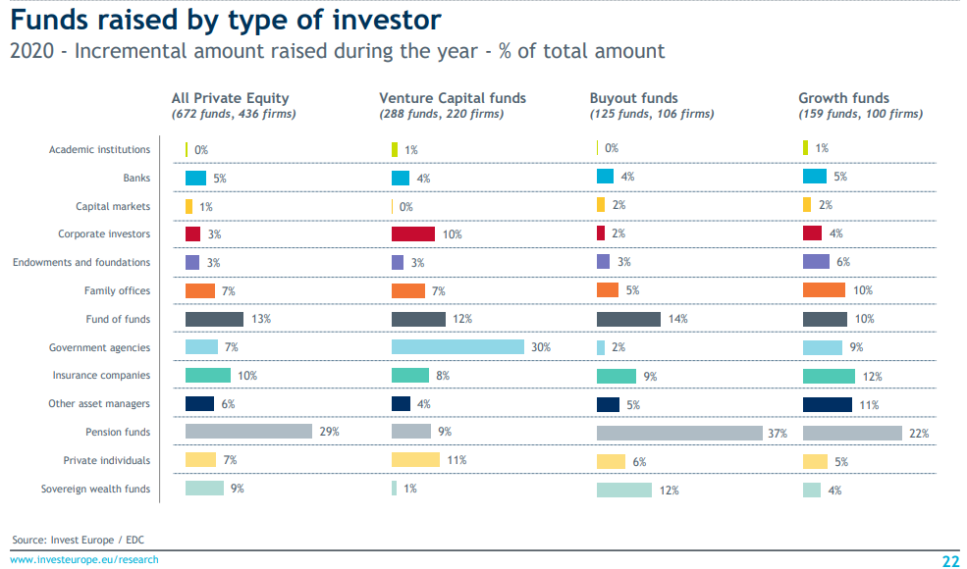
Governments invest heavily In PE (VC)

Slide 6
Is gov’t money (GLP) well spent?
A 1st or 2nd fund with GLP has higher probability of raising a second fund, but not a 3rd fund or beyond
GLP commitment is sticky
Funds with GLP have same proportion of successful exits (EIF funds have higher)
GLPs help develop the VC industry
Source: Standaert, Alperovych, Manigart & Quas, 2021

