Slide 1

MTFs and OTFs: Transparency Implications for Non-Equities
Unravelling Ariadne's MiFID II Thread
Pre- and post-trade transparency for non-equity markets
ECMI
Alexander McDonald
06th April 2017, Brussels
WMBA & LEBA
Notes:
Article 2; Definitions; (7) ‘organised trading facility (OTF)’ means any system or facility, which is not a regulated market or MTF, operated by an investment firm or a market operator, in which multiple third-party buying & selling interests in financial instruments are able to interact in the system in a way that results in a contract in accordance with the provisions of Title II of Directive [new MiFID];
1

Slide 2
Venue Obligations under RTS 26
Responsibility for checking credit of client orders Cf. Arrangements in place
Article 2 of draft RTS 26 referring to, ‘Pre-trade credit checks for cleared derivatives executed on a trading venue
  the rules of the trading venue require that each member or participant of the trading venue, which is not a clearing member of a CCP through which the cleared derivative transaction is cleared, has a contractual arrangement with a clearing member of the CCP under which the clearing member automatically becomes counterparty to the cleared derivative transaction;
  the rules of the CCP provide that the cleared derivative transaction executed on a trading venue is cleared automatically and immediately, with the clearing member referred to in point (a) becoming the counterparty to the CCP;
  the rules of the trading venue provide that the member or participant of the trading venue or its client becomes counterparty to the cleared derivative transaction, pursuant to direct or indirect clearing arrangements
at point of execution a venue will ‘allege’ a transaction to the two counterparties, typically via a piece of third party middleware.
the term, ‘automatically and immediately’ refers specifically to post-arrangement processes at the CCP where matching and novation actually occur following the affirmation of the trade by both counterparties
CCP clearing takes place distinctly and separately from the venue, the venue may meet the condition expressed in 2.1(b) by delivering the arranged transaction to the CCP in accordance with the rules of that CCP.
WMBA & LEBA

Slide 3
Venue Obligations under RTS 26
Exemption will apply to any trade to executions where clearing is delivered ‘instantly with automatic certainty’ (where the question still exists can this be possible with manual affirmation at MarkitWire)
And if not
Self-clearers are exempt
The venue has the obligation to ‘provide a facility’ for checking but is not actually obligated to check each order itself – only that a check has happened if for a non-self-clearer
The credit checking facility can take any form as may be agreed by client’s FCM
Client Clearing – Use of Tokens?
The utility of the token is that credit has been vouchsafed for that amount and tenor and you don’t need to keep asking every time the price of the unfilled order might change....
WMBA & LEBA

Slide 4
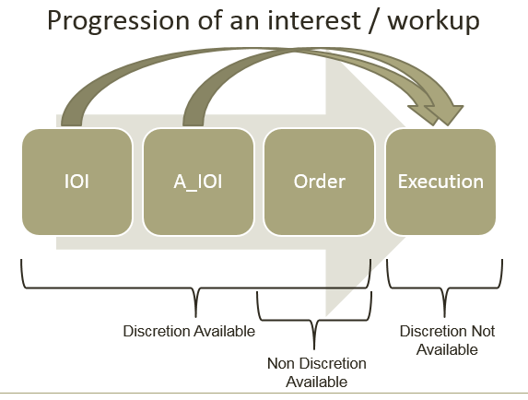
Arranging and Executing
Under whose Rules?
CP15/43: Markets in Financial Instruments Directive II Implementation – Consultation Paper I
WMBA & LEBA
Is the Location of Execution Moving?
Common Law versus Settlement Finality
“Void ab Initio”
Linkages to EMIR, SFTR, REMIT and CSDR

Slide 5
Arranging and Executing
(1) MTF Platform Modelled instruments
These are financial instruments suited to Order Book trading via APIs with immediate Straight Through Processing such as CDS Indices, CDS single names, G10 IRS, Government, Sovereign, Corporate & EM Bonds and FRNs.
As these prices are On-MTF live and executable, clearly these are Orders from the outset.
(2) OTF Platform Modelled Instruments
These are financial instruments unsuited to APIs and are instead accessed via a GUI and OTF person managing prices typed onto a screen such as Swaptions, Caps&Floors, Cross Currency IR & Basis Swaps, Inflation Swaps and Options, Metals Forwards and Options, Convertible bonds with Equity delta hedge, CDS Index Options and Tranches with Index delta hedge.
As these trades are preceded by an electronic posting, are executed On-OTF using broker discretion with significant ‘post-arrangement parametrisation’, and can fail execution at either points (ii) and (iii) due to post-arrangement client disagreement on the necessary parameters, these prices do not become firm Orders throughout this sequence of events.
(3) OTF Whiteboards for Indications of Interest (IOIs)
These are complex financial instruments and strategies created ‘ad-hoc’ from customer input and are displayed on customer facing whiteboards as Indications of Interest where customers can express a desire to trade but actual execution is achievable only once multiple trade parameters are iterated and captured in bespoke middle office trade capture templates such as Constant Maturity Swaps (CMS) and CMS Spread Options (binary options on spreads between different tenor constant maturity swaps), Equity Variance Swaps, Total Return Swaps, Cliquet (ratchet) Options and Callable Swaps.
WMBA & LEBA

Slide 6
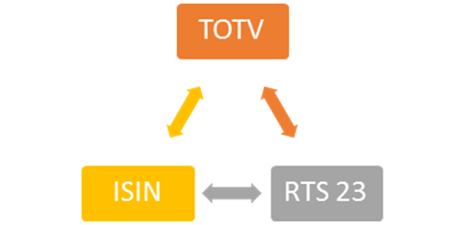

TOTV and ISINs
Granularity – what is an instrument?
Fixed Horizon verses Fixed Term Instruments; Start Date & End Date
Strikes and additional attributes
Transparency
WMBA & LEBA

Slide 7
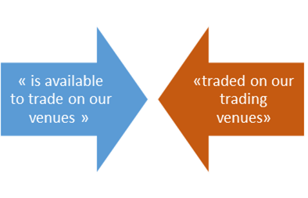
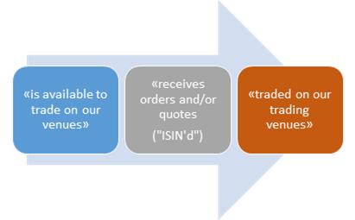

Traded on a Trading Venue [‘TOTV’]
MiFIR 4.2.3.5 Article 18: Obligation for systematic internalisers to make public firm quotes in respect of bonds, structured finance products, emission allowances and derivatives: Investment firms shall make public firm quotes in respect of bonds, structured finance products, emission allowances and derivatives traded on a trading venue for which they are systematic internalisers and for which there is a liquid market when the following conditions are fulfilled…
WMBA & LEBA
… become the same as made public by venues
RTS23, Article 3:
Identification of financial instruments and legal entities: 1. Prior to the commencement of trading in a financial instrument in a trading venue or systematic internaliser, the trading venue or systematic internaliser concerned shall obtain the ISO 6166 International Securities Identifying Number ('ISIN') code for the financial instrument.
“prior to…”
“prior to…”

Slide 8
Venue Perimeter
Multilateral versus Bilateral
  Derivatives versus Cash
MiFID II arranging activity – awaiting the FCA policy statements to CP15/43 and the ESMA Q&As
Everything comes back to the “Rulebook of the Venue” – this transposes the MiFID requirements (Level 1, 2, Guidance)
Introducing Interests, Orders, Quotes and Trades
  CLOBs
  Voice
  Work-up
  Auctions
  RFQ
  Other
At what point does the Rulebook take affect (TOTV)
  Pre-trade versus Execution
  Packages
  Blocks
  Non-MiFID Participants
  Equivalence across the Third Country perimeter
WMBA & LEBA

Slide 9
Traded on a Trading Venue [‘TOTV’]
What is an instrument? – all questions lead to a consideration of Granularity
WMBA & LEBA
RTS 23; Data Standards & Formats for Financial Instrument Reference Data
Details to be reported as financial instrument reference data
  23 fields, plus a further 25 instrument specific
  Including: ISIN, Fixed Rate (or Price), Expiry Date; Strike Price
This leads to an almost infinite creation of derivative instruments, even with the price/rate removed it is still a very large data set, yet unspecific
RTS 2; Transparency Requirements in Respect of Bonds, Structured Finance Products, Emission Allowances & Derivatives
Details of asset class, sub-asset class and sub-class to be reported as financial instrument transparency classification
  Segmentation Criterion
  Maturity Buckets
  No requirement to Include ISIN
  No Fixed Rate (or Price)
  No Expiry Date, No Strike Price

Slide 10
Transparency
MiFID2 will require market participants to provide pre- and post- trade transparency reporting for bonds and derivatives orders, quotes and trades.
Transactions shall be aggregated per ISIN-code.
The requirement to report the order, quote and trade may be waivered or deferred depending upon the liquidity status of the instrument, TOTV considerations, the SSTI and LiS values.
The application of waivers and of deferrals will be at the discretion of each individual NCA, yet common across each NCA domain.
WMBA & LEBA
Obligation | Liquid < SSTI | Liquid > SSTI < LiS | Liquid >LiS | Illiquid
Pre-trade | Real Time | Nil [composite for venues] | Nil | Nil
Post-trade | Real Time | T+2 (and up to four weeks) | T+2 (and up to four weeks) | T+2 (and up to four weeks)

Slide 11
Packages
Level 1 - ‘Quickfix’; much focus on the number of legs and components
Scope of the ESMA RTS beyond derivatives
Revised, BoS for written approval, will be sent to EU_COMM at month end when it will be published
Package definition and ‘Liquid Packages’
  Illiquid component legs
  Components across waiver thresholds
Fragmenting Liquidity
Basis Trading
Multiple venues
Post trading packages
Cross boarder equivalence and deference
WMBA & LEBA

Slide 12
Transaction Reporting by Venues
Venues have to TR on behalf of Non-MiFID Participants (Article 26(5)
65 different fields per transaction of which only a few are difficult, if not impossible, for the trading venue to obtain if the information is not voluntarily provided
Sensitivity of the data
Technical difficulties with obtaining all the data in time
Need for guidance that ‘best” or “reasonable” efforts are sufficient
Lack of level playing field between Regulated Venues & Bilateral Trading
if a non-MiFID firm is trading matched principal or agency the natural person details regarding the client of the non-MiFID firm are required;
regardless of trading capacity, the natural person details of the person responsible for investment decision is required; and
trading venues do not routinely have access to any allocations
ESMA’s guidance (s2.1.4.2 of the Final Report issued on 10 October) is very helpful in indicating that the trading venue should recover and validate the information by the end of the next trading day.
WMBA & LEBA

Slide 13
FX Forwards and Swaps
Rewriting the RAO 84 Commercial Purposes Exemption as ‘Means of Payment’
  Forwards are now Derivatives
  Options are now Packages
Level 1 ‘QuickFix’ - 2.1.d exemptions for NFCs
Instrument Perimeter:
Are simple FX swaps:
  Two instruments (favoured by US treatment of the FX Forward)
  One Package (favoured by Trading Book Rules)
  One instrument (as per RTS 2)
Where are FX Markets offered, arranged and transacted
  MTFs and OTFs with European sessions?
  Participants and venues have transacted under UK Law and always booked globally back to the UK
  ‘Reverse Solicitation’ and Brexit compounding requirements for clarity
WMBA & LEBA

Slide 14
Matched Principal
OTFs allowed to engage in matched principal trading in bonds, structured finance products, emission allowances, and derivatives that have not been declared subject to the clearing obligation under Article 5 of EMIR, provided the client consents.
“Matched principal trading” is defined as “a transaction where the facilitator interposes between the buyer and seller to the transaction in such a way that it is never exposed to market risk throughout the execution of the transaction, with both sides executed simultaneously and the transaction is concluded at a price where the facilitator makes no profit or loss, other than a previously disclosed commission, fee or charge for the transaction.”
The operator of an OTF must provide the relevant competent authority with information explaining its use of matched principal trading.
The competent authority will monitor the OTF operator's engagement in matched principle trading to ensure that it complies with the definition and to ensure that it does not give rise to conflicts of interest between the OTF operator and its client
WMBA & LEBA
Notes:
Non position taking intermediaries focused on arranging trades and discovering liquidity in OTC markets
WMB is an “IDB” but not a Broker-Dealer
Authorisations – Limited Licence or Limited Activity permissions within EU
Flexible Execution - Enable the “Ecology of the Market-Place” to function, develop and evolve
Symbiotic relationships with Exchanges and CCPs
Operate 33 Multilateral Trading Facilities and numerous automated trading platforms around the globe
3 Major modes
Name Give Up
Matched Principal
Exchange Agency

