Slide 1
Unconventional monetary policy and credit rating dynamics
Nordine Abidi
European Central Bank
Matteo Falagiarda
European Central Bank
Ixart Miquel-Flores
European Central Bank
10 October 2018
2018 ECMI Annual Conference: Sustaining Growth through Innovation in Capital Markets
Disclaimer: The views expressed are those of the authors and do not necessarily reflect those of the European Central Bank.

Slide 2
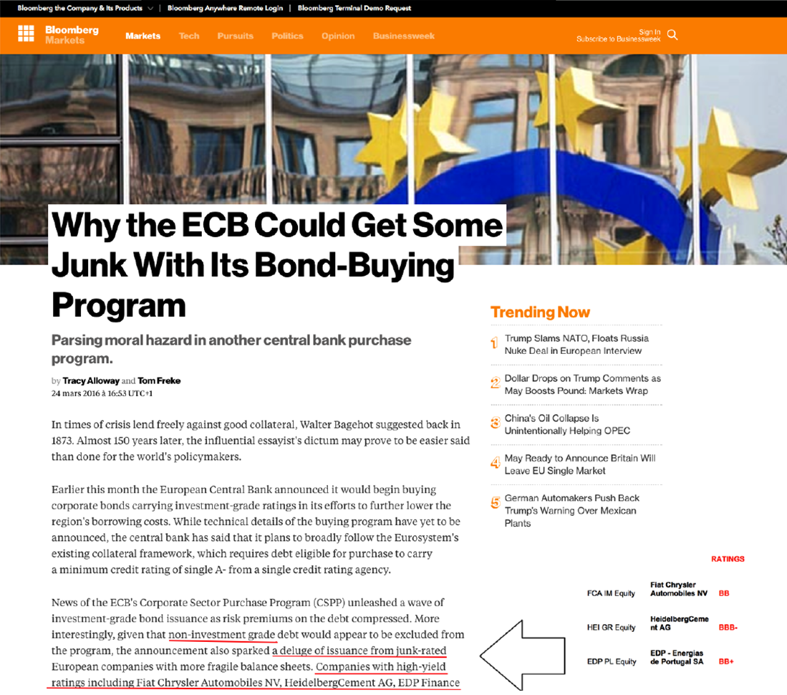
Rating and corporate QE

Slide 3
Motivation
"The ratings [. . . ] are and must be construed solely as, statements of opinion and not statements of fact or recommendations to purchase, sell, or hold any securities." (Rating Agency Disclaimer)
Nevertheless, still important reliance on CRAs by market participants:
Direct: restrictions on investing in non investment-grade bonds
Indirect: benchmark with underlying ratings
Less known:
Explicit reliance on CRAs by major central banks for monetary policy (ECB, Fed, etc.)
This paper:
  Investigate the relationship between CRAs behavior and unconventional monetary policy
  Understand the consequences of central banks reliance on CRA’s for credit judgement

Slide 4
This paper
Well known trade-off faced by CRAs (pleasing the issuer vs. reputational costs, Bolton et al., 2012)
Corporate Sector Purchase Programme (CSPP) of the ECB:
  Ideal laboratory experiment for identification:
    Unexpected by market participants
    Direct link between ECB purchases and corporate entities
    Rating-based rule of thumb for CSPP eligibility
The eligibility to be purchased by the ECB under the CSPP relies explicitly (but not entirely) on a rating-based rule-of-thumb (“a minimum first-best credit assessment of at least credit quality step 3”)
We call it first-best rating rule ↔ at least a BBB- from at least one CRA

Slide 5
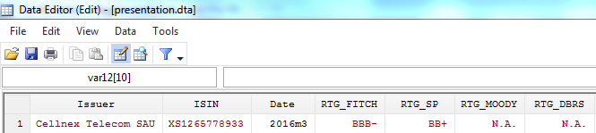
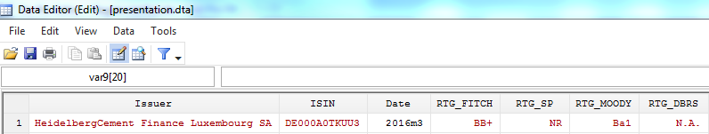
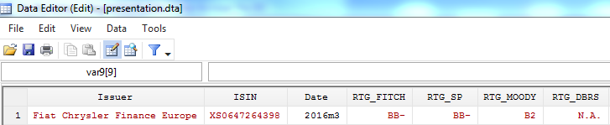
Intuition: rating-based rule of thumb
CSPP-eligible
Below,
but close to,
eligibility
Below, but
farther away
from eligibility

Slide 6
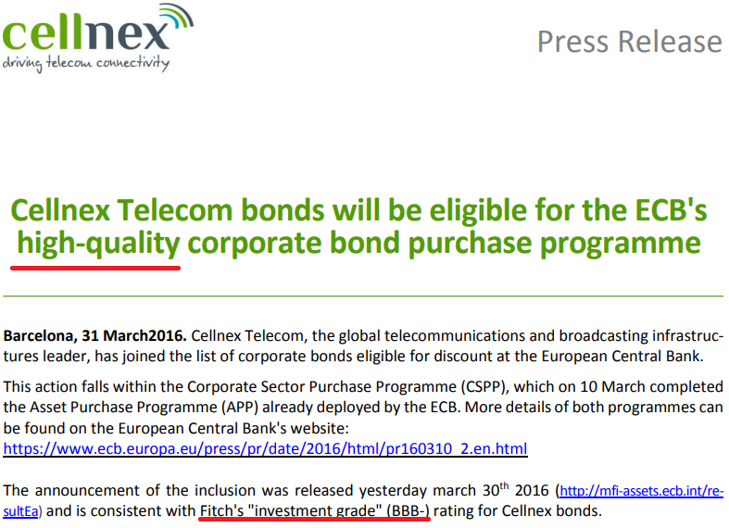
The first-best rating rule at work
Sources: Company website

Slide 7
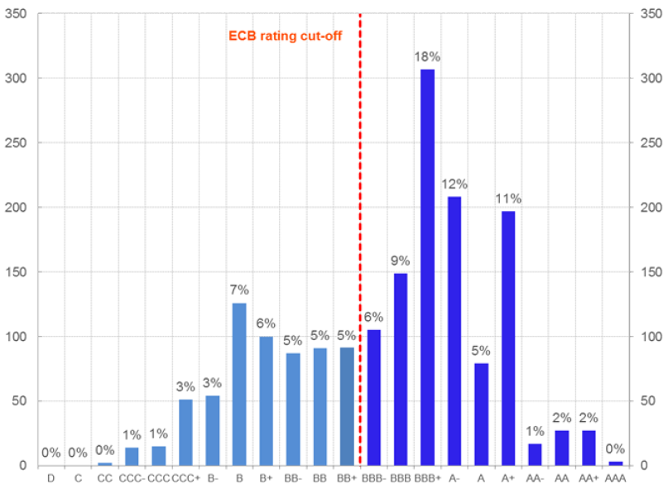
The first-best rating distribution in March 2016
Bonds by first-best rating
(March 2016 – number and percentages)
Sources: Bloomberg, Authors' computation.

Slide 8
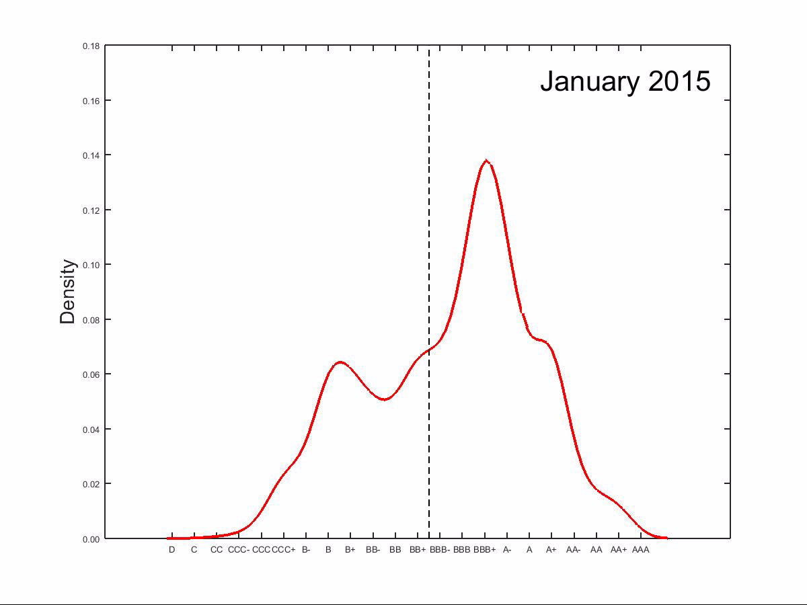
Evolution of the first-best rating distribution
CSPP Short Movie
(January 2015 - December 2017 – Kernel density)

Slide 9
Concluding remarks and policy recommendations
Sum up:
The CSPP appears to have had a significant impact on the behavior of CRAs
The impact is mostly noticeable for bonds located below, but close to, the CSPP eligibility frontier
Policy recommendations:
Acknowledging the (unintended) effects of the explicit reliance on CRAs when designing conventional and non-conventional monetary policy
No normative conclusions on the use of external rating agencies and on the ESCF…
  …whose key role is well documented (Bindseil et al., 2017)

