Slide 1
Half time for CMU: Taking Stock
CEPS/ECMI Roundtable on CMU Mid-term review
Brussels, 4 July 2017

Slide 2
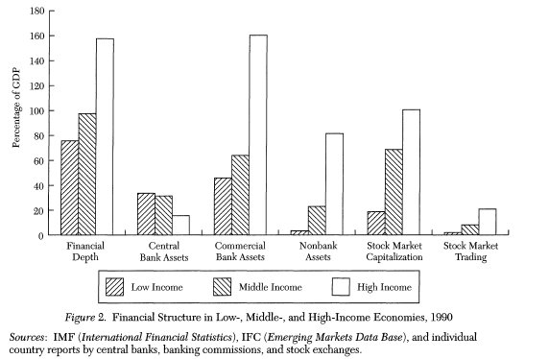
Capital Market and financial development
Source: Ross Levine, (1997) 35 J of Econ Lit 688

Slide 3
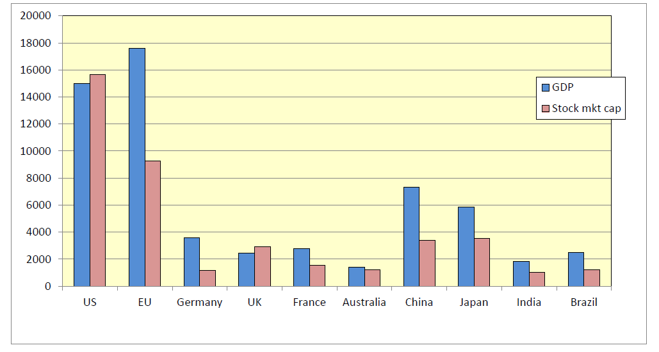
Capital Market and financial development
Stock market capitalisation and GDP for leading economies, 2011 ($bn)
Source: World Bank, World Development Indicators

Slide 4
The CMU
Rationales:
Strengthening the integration of (national) capital markets -> creation of welfare
Reducing European firms’ dependence from bank financing / ‘diversification’
Strengthening the Eurozone through ‘private risk sharing’
Offering investment alternatives in times of low interest rates
Encouraging private pension arrangements
Political signal to the UK and the Single Market

Slide 5
Political relevance
(1) Commitment to the EU-28
Post-crisis regulatory body was mostly devoted to the Eurozone+ instead of EU-28
Banking Union, SSM, SRM, FTT: further Eurozone integration, risk of Single Market bifurcation
The new agenda seeks to overcome this trend

Slide 6
Political relevance
(2) ‘Market making’ renaissance
Pre-2007: EU Single Market creation, free movement of capital, in particular FSAP 1999
Post 2007: ‘market shaping’ re-regulation, stability-oriented and crisis-fighting
Since 2014/15: market creation back on the agenda (arguably closer to the core EU agenda)

Slide 7
Political relevance
(3) Political promise
CMU promises ‘welfare creation’, not ‘banker bashing’
Context – promise of more ‘jobs’ and ‘growth’
Response to a growing weariness of crisis-related activities and austerity
Reaction to US supremacy in securities markets (‘transatlantic benchmarking’)

Slide 8
Political relevance
(4) Specific importance for the UK
Financial sector & City of London stand to benefit from a continent-spanning ‘true’ single market
Single market for capital popular with British business groups and policy makers
‘market-making’ concept more supported than some of the post-crisis measures (cf. litigation!)
An attempt to address the growing EU frustration in the UK, in a bid to influence the 2016 Brexit referendum

Slide 9
CMU and the UK
CMU is ‘a golden opportunity for the UK […], a means to demonstrate afresh that the City of London, and the financial sector which is centred there, is an asset not only to the UK economy but to the EU as a whole’
House of Lords’ EU Economic and Financial Affairs Sub-Committee, March 2015

Slide 10
CMU and the UK
What about other, smaller MS?
Low risk of ‘losing out’ on a harmonized framework – small, open economies have benefitted from harmonization in the past (Alpen & Thygesen 2015)
Nordics will benefit disproportionately: market-based finance much more common in northern Europe than in other MS (cf FSAP)
Other MS expect to ‘learn’ from developed capital markets
Correspondingly, no significant opposition to be expected from other MS
Allows policy makers to take a more pro-EU stance

Slide 11
Challenges at half time

Slide 12
Challenges
(1) Brexit
Different views:
Does Brexit make CMU an illusion?
Do we need it now more than ever?
Change in direction?
Different political influences shaping CMU
Lack of the ‘liberal voice’
No more learning from the City of London

Slide 13
Challenges
Brexit (at least) changes character and purpose of CMU
EU27 need to offer a coherent alternative and a strong capital market without the UK
Threat of regulatory arbitrage – EU27 cannot afford to be too rigid

Slide 14
Challenges
A different view: Brexit will not significantly affect CMU
Two scenarios:
UK stays (‘soft Brexit’): Strong case for continued UK access to the EU Single Market for capital (Ringe 2017) – special deal to be expected
UK leaves (‘hard Brexit’): CMU will remain an offer and a token of the negotiations to the last moment (both 2019)
-> EU27 have strong incentives to keep CMU attractive for UK
But: after Single Market exit is certain / if CMU is delayed – CMU will be shaped by EU27

Slide 15
Challenges
(2) Lack of ambition?
Genuine ‘Capital Markets Union’ would have meant
one single capital market, with
one single market watchdog (cf Banking Union!)
Consolidating market infrastructure – in particular stock exchanges and regulated markets
Lack of coherence – where’s the golden thread?
Conceptual approach is unclear – bottom-up? Top-down? 29th regime? (what works in which situation?)
Avoid too much harmonisation

Slide 16
Challenges
(3) Slow progress
Only one measure completed so far
Revision to Prospectus Directive
Political difficulties in EP and Council; influence of interest groups
Risk of jeopardising objective – e.g. STS may become overcomplicated

Slide 17
Challenges
(4) Digitalisation
CMU is very vague on digitalisation
Could be great opportunity – technology as a bridge between markets (Nasdaq 2016)
Power to increase the role of capital markets
Bring them closer to companies and investors
Driver of competition, helps to create a more competitive landscape
Many EU rules do not fit the new digital age
Potential of blockchain technology to help break down national barriers

Slide 18
Recommendations
Use Brexit as an opportunity, seek to keep London & UK influence on board
Avoid stifling of regulation
Allow for diversity, experimentation, mutual learning
EU contribution most helpful in cross-border access, infrastructure, fair treatment
Harness technology

Slide 19
Overall assessment
A ‘pretext for doing absolutely nothing’?
CMU as a predominantly political project
Brexit as a risk but also an opportunity: CMU could (and should) be a bridge to the UK
Focus on cross-border ‘facilitation’
Benefits of IT and fintech

Slide 20
Professor Wolf-Georg Ringe
University of Hamburg
Institute of Law & Economics
Email: georg.ringe@uni-hamburg.de
See my research at http://ssrn.com/author=836081

