Slide 1
Asset Management in the EU: Which way forward? Asset Managers and Systemic Risk
Carsten Detken
Head, Financial Stability Surveillance
Directorate General Macroprudential Policy and Financial Stability
European Central Bank
CEPS / ECMI – 10 March 2016
Views presented are my own and might not reflect those of the ECB or the Eurosystem

Slide 2
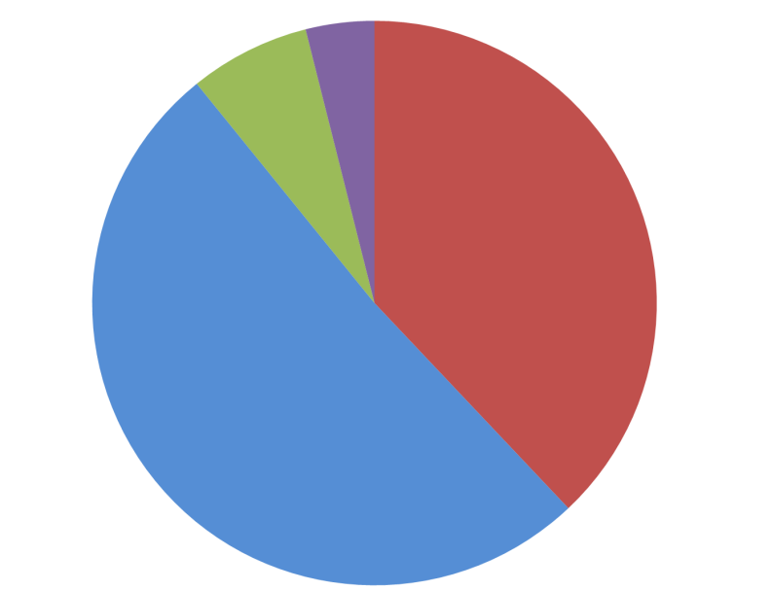
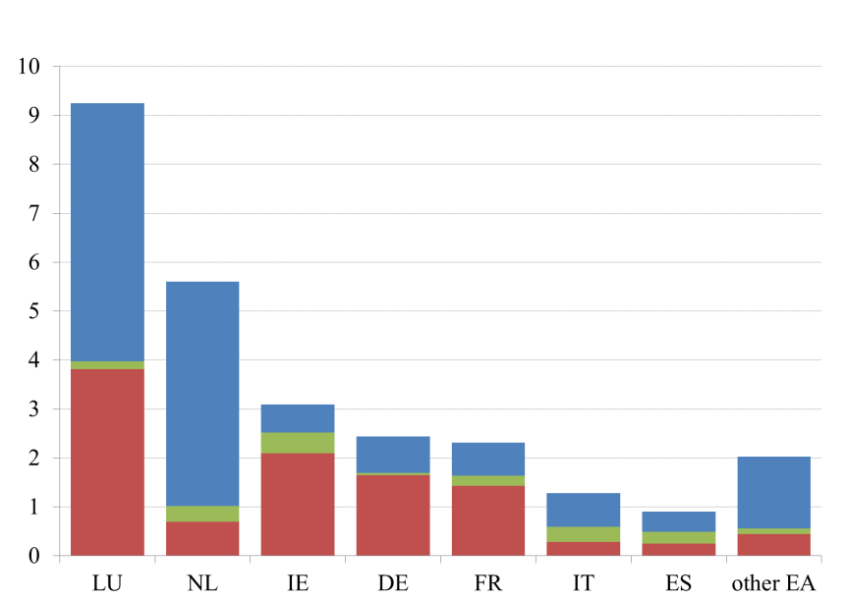
A growing sector in the euro area …
Sectoral and geographical breakdown of non-bank assets
Growth in bank and non-bank financial assets since 2010 up to Q3 ’15
(index of notional stocks)
MMF 4%
FVC
7%
Non-MMF
investment
funds
Non-MMF investment funds 38%
Residual
51%
Shadow
banks
Banks
Residual
FVCs
Investment funds
MMFs
FVCs

Slide 3
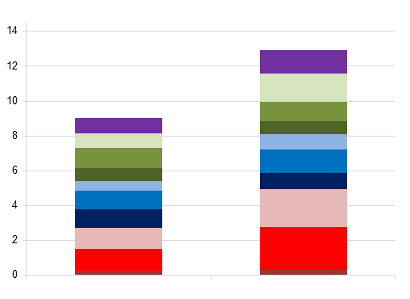
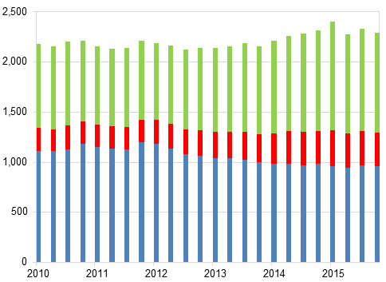
Supports real economic activity in and outside the euro area...
Balance sheet of non-bank financial sector
(narrow shadow bank definition)
Credit provision to the euro area non-financial sector by euro area shadow banks
(narrow definition)
Other
Government
debt
securities
Financial Sector
Equity
Debt
NFC debt
securities
Loans
Non-Fin
Sector
Equity
Debt
Loans
Loans
Equity
Non-EA
Debt
Mar-10
Dec-15
EUR 2.3 trillion of credit given to the euro area non-financial sector
(equivalent to 15% of bank credit)
… of which EUR 1.3 trillion in credit to non-financial corporates and households alone
Credit to the non-financial sector is only 18% of the balance sheet, due to large holding of:
Equities
Securities of the EA financial sector
Non-euro area assets

Slide 4
… but also presents risks to financial stability
Growing prevalence of callable equity
… which is not a stable source of funding
Large footprint of systemically important institutions linked to banks
Low measures of leverage are misleading due to synthetic leverage and riskier equity
Funds promise daily liquidity … but buffers of liquid assets have fallen
Strengthening of contagion channels to the wider financial system and real economy

